Slide 1
C Basics

Slide 2
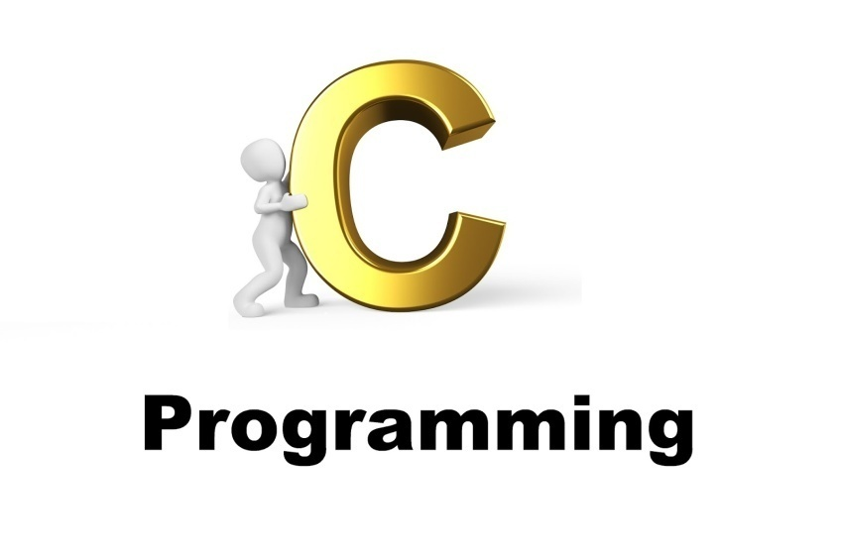
Welcome to the World of C
Notes:
This presentation demonstrates the new capabilities of PowerPoint and it is best viewed in Slide Show. These slides are designed to give you great ideas for the presentations you’ll create in PowerPoint 2010!
For more sample templates, click the File tab, and then on the New tab, click Sample Templates.

Slide 3
1. Through this lecture, students will be learning transition from Scratch to C programming
2. Students will be understanding the basics of C
Learning
Outcomes

Slide 4
Contents
Introduction to C
Data types
Variables
Operators

Slide 5
What is C?
Created by Dennis Ritchie at AT&T Labs in 1972
Easy to build a compiler for C.
powerful and efficient, achieve the efficiency of assembly code
used for system programming as well as for applications programming
standardized
High level , general purpose structured programming language
Highly Portable. (related to OS)
base language of any other programming language
Ability to extend itself because it can easily adopt new features.

Slide 6
Features of C
Syntax is clear and understandable
Portable and can run on any machine irrespective of type of CPU and machine.
Modular language which is easy to manage and understand
Quicker compiler: Speed of executing C programs is very fast
Easy to learn and debug
Built in functions available to perform various operations
User Friendly language, tells the location, type and number of the line in which error is present
Supports Pointers which tells where variables are stored in the computer memory.
Case sensitive language

Slide 7
C development Cycle
Library Files
1
2
3
Source Code
Object Code
Edit Program
{editors like gedit, vi}
Compile
Link Object Code
{gcc –c test.c
–o test}
Executable {./test}

Slide 8
Steps in learning English Language vs Learning C
Alphabets
Words
Sentences
Paragraphs
Alphabets
Digits
Special Symbols
Constants
Variables
Keywords
Instructions
Program

Slide 9
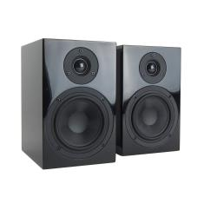
Tokens of C
The words formed from the character set are building blocks of C
The character set of C consist of all the alphabets of English language consisting of Alphabets (a to z, A to Z), Numeric (0,1 to 9), and Special Symbols ({,},[,],?,+,-,*,/,%,!,;, and more)
Identifiers
Keywords
Constants
Operators
Punctuation Symbols

Slide 10
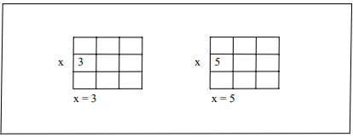
Constants
Constant is an entity that doesn’t change whereas a variable is an entity that may change.
Here 3 is stored in a memory location and a name x is given to it. Then we are assigning a new value 5 to the same memory location x. This would overwrite the earlier value 3, since a memory location can hold only one value at a time.

Slide 11
Types of Constants
Character
Real
Integer

Slide 12
Rules for Constructing Integer Constants
An integer constant must have at least one digit.
It must not have a decimal point.
It can be either positive or negative.
If no sign precedes an integer constant it is assumed to be positive.
No commas or blanks are allowed within an integer constant.
The allowable range for integer constants is -32768 to 32767.

Slide 13
Rules for Constructing Real Constants
A real constant must have at least one digit.
It must have a decimal point.
It could be either positive or negative.
Default sign is positive.
No commas or blanks are allowed within a real constant.
The exponential form of representation of real constants is usually used if the value of the constant is either too small or too large.

Slide 14
Rules for Constructing Real Constants expressed in exponential form
The mantissa part and the exponential part should be separated by a letter e.
The mantissa part may have a positive or negative sign.
Default sign of mantissa part is positive.
The exponent must have at least one digit, which must be a positive or negative integer. Default sign is positive.
Range of real constants expressed in exponential form is -3.4e38 to 3.4e38.

Slide 15
Rules for Constructing Character Constants
A character constant is a single alphabet, a single digit or a single special symbol enclosed within single inverted commas. Both the inverted commas should point to the left. For example, ’A’ is a valid character constant whereas ‘A’ is not.
The maximum length of a character constant can be 1 character.
Ex.: 'A' 'I' '5' '='

Slide 16
Types of Variables
Names given to locations in memory
Locations can contain integer, real or character constants
Types of variables depend on the type of constants it can handle
Particular type of variable can hold same type of constants
Rules for constructing different types of variables are different

Slide 17
Rules for Constructing Variable Names
A variable name is any combination of 1 to 31 alphabets, digits or underscores.
Some compilers allow variable names whose length could be up to 247 characters.
Do not create unnecessarily long variable names as it adds to your typing effort.
The first character in the variable name must be an alphabet or underscore.
No commas or blanks are allowed within a variable name.
No special symbol other than an underscore (as in gross_sal) can be used in a variable name.
Ex.: si_int, m_hra, pop_e_89

Slide 18
Quiz?

Slide 19
Which of the following are invalid variable names and why?
BASICSALARY
_basic
basic-hra
#MEAN
group.
422
population in 2006
over time
mindovermatter
FLOAT
hELLO
queue.
team’svictory

Slide 20
Keywords
Words whose meaning have been already explained to compiler
Cannot be used as variable names
Also called reserved words
Total 32 keywords

Slide 21
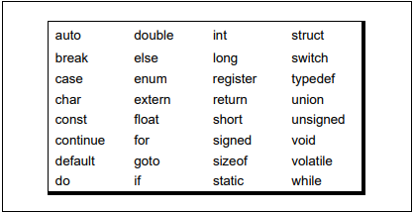
List of Keywords

Slide 22
C Data Types
Primitive
Data Types
Derived
Data Types
Integer
Arrays
Float
Pointers
Structures
Character
Enums

Slide 23
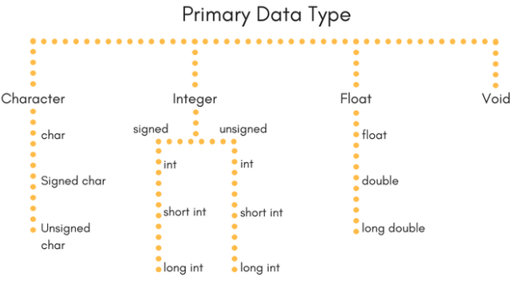

Slide 24
Integer type (16-bit/32-bit compiler)
Type | Size (bytes) | Range | Format Specifier
int or signed int | 2 /4 | -32768 to 32767 | %d
Unsigned int | 2 /4 | 0 to 65535 | %u
Short int or signed short int | 1 /2 | -128 to 127 | %hd
Unsigned short int | 1 /2 | 0 to 255 | %hu
Long int or signed long int | 4 /4 | -2147483648 to 2147483647 | %ld
Unsigned long int | 4/4 | 0 to 4294967295 | %lu

Slide 25
Floating point type
Type | Size (bytes) | Range | Format Specifier
Float | 4/4 | 3.4E-38 to 3.4E+38 | %f
Double | 8/8 | 1.7E-308 to 1.7E+308 | %lf
Long double | 10/12 | 3.4E-4932 to 1.1E+4932 | %Lf

Slide 26
Character type
Type | Size (bytes) | Range | Format Specifier
char or signed char | 1 | -128 to 127 | %c
Unsigned char | 1 | 0 to 255 | %c

Slide 27
Identifiers
sequence of letters and digits, but must start with a letter
Upper and lowercase letters can be used
Identifiers are case sensitive.
used to name, variables, functions etc.
Underscore
( _ ) is treated as a letter.
Valid: Root, _getchar, __sin, x1, _1, If
Invalid: 324, short, price$, My Name

Slide 28
Operators
define how the variables and literals in the expression will be manipulated.
Assignments operators
Arithmetic operators
Relational operators
Logical operators
Bitwise operators

Slide 29
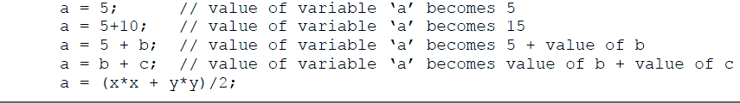
Operators
Assignment operators
Assignment operator (=) is used to assign a value to a variable.

Slide 30
Operators
Assignment operators
In C lots of shortcut are possible by using Shorthand operators.
For ex.
a = a + b can be written as
a += b
a = a * b can be written as
a *= b
a = a / b can be written as
a /= b
a = a - b can be written as
a -= b

Slide 31
Operators Contd…
Arithmetic operators: C supports five major operators.
Addition +
Subtraction –
Division /
Multiplication *
Reminder %

Slide 32
Operators Contd…
Relational operators
Equal to ==
Not equal to !=
Less than <
Less than equal to <=
Greater than and greater than equal to (>, >=)

Slide 33
Operators contd…
Relational Operators
The expression
operand1 relational-operator operand2
takes a value of 1 if the relationship is true and 0 if relationship is false.
Example
int a = 25, b = 30, c, d;
c = a < b;
d = a > b;
value of c will be 1 and that of d will be 0.

Slide 34
Operators contd…
Logical Operators
&&, || and ! are the three logical operators.
expr1 && expr2 has a value 1 if expr1 and expr2 both are nonzero.
expr1 || expr2 has a value 1 if expr1 and expr2 both are nonzero.
!expr1 has a value 1 if expr1 is zero else 0.
Example
if ( marks >= 40 && attendance >= 75 ) grade = ‘P’
If ( marks < 40 || attendance < 75 ) grade = ‘N’

Slide 35
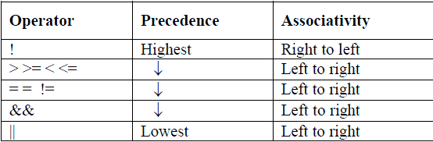
Operators contd…
Logical Operators follows following rules of precedence.

Slide 36
Operators
Increment and Decrement Operators
The operators ++ and –- are called increment and decrement operators.
a++ and ++a are equivalent to a += 1.
a-- and --a are equivalent to a -= 1.
++a op b is equivalent to a ++; a op b;
a++ op b is equivalent to a op b; a++;
Example
Let b = 10 then
(++b)+b+b = ?
b+(++b)+b = ?
b+b+(++b) = ?
b+b*(++b) = ?

Slide 37
Rules of operator precedence
BODMAS rules and associativity rules follows
(Highest)
^ Right associative
*,/ left associative
+,- left associative
Addition and subtraction – at same level but lower than the above mentioned category (evaluation left to right)
Multiplication, division and reminder on same precedence (evaluation left to right)
Exponent are right associative( evaluate right to left)

Slide 38
Ex:
A + B +C means (A + B) + C
A ^ B ^ C means A ^(B ^ C), where ^ stands for exponentiation

Slide 39
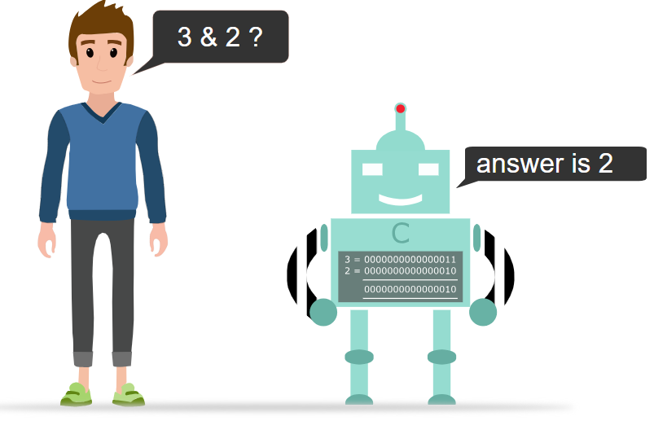
Bitwise Operator
Operates on each bit of data.
Operates on integer operands such as int, char, short int, long int.

Slide 40
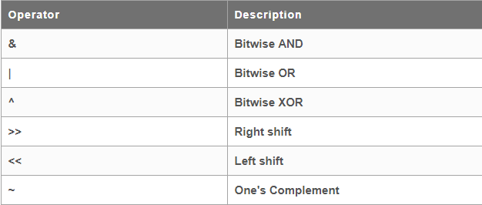
C Bitwise Operators
C provides 6 bitwise operators to operate on individual bits in an integer quantity

Slide 41
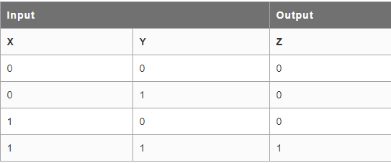
Bitwise AND
Bitwise AND operator, &, combines corresponding bits in its two operands such that if both bits are 1, the result is 1 otherwise the result is 0.

Slide 42
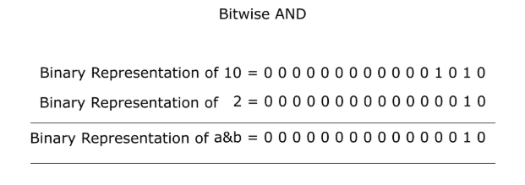
Bitwise AND operator program
#include <stdio.h>
int main()
{
int a = 10, b = 2;
printf("a & b = %d ", a & b);
return 0;
}
2

Slide 43
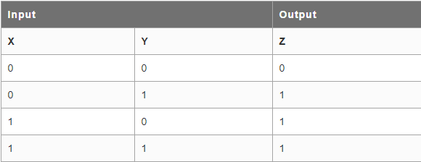
Bitwise OR
The bitwise OR operator, |, combines corresponding bits such that if either or both bits are 1, then the result is 1. Only if both bits are 0 is the result 0.

Slide 44
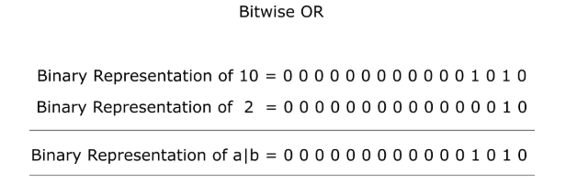
Bitwise OR operator program
#include <stdio.h>
int main()
{
int a = 10, b = 2;
printf("a | b = %d ", a | b);
return 0;
}
10

Slide 45
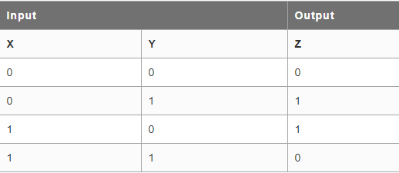
Bitwise XOR
Bitwise exclusive OR (XOR) operator, ^, combines corresponding bits such that if both bits are the same the result is 0; otherwise, the result is 1

Slide 46
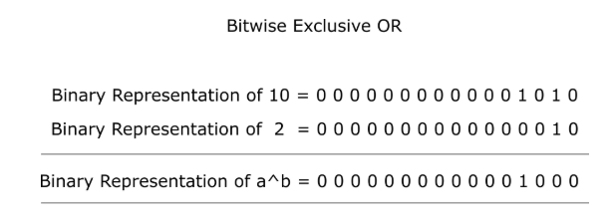
Bitwise XOR operator program
#include <stdio.h>
int main()
{
int a = 10, b = 2;
printf("a ^ b = %d ", a ^ b);
return 0;
}
8

Slide 47
Right Shift Operator (>>)
Right shift operator requires two operands.
It takes Left hand side operand as bit sequence or bit Pattern to be shifted and right hand side operand as positive integer or unsigned integer that indicates the number of displacements or bit positions to the right.

Slide 48
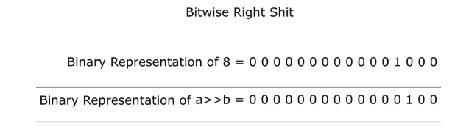
Right Shift operator program
#include <stdio.h>
int main()
{ int a = 8,b;
a>>= 1;
b = a;
printf("The Right shifted data of 8 by 1 = %d ",b);
return 0;
}
4

Slide 49
Left Shift operator (<<)
Left shift operator also requires two operands.
It takes Left hand side operand as bit sequence or bit Pattern to be shifted and right hand side operand as positive integer or Unsigned integer that indicates the number of displacement or bit positions to the left.

Slide 50
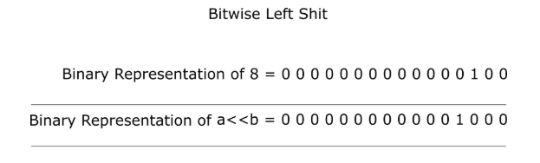
Left shift operator program
#include <stdio.h>
int main()
{
int a = 4, b;
a<<= 1;
b = a;
printf("The Left shifted data of 4 by 1 = %d ",b);
return 0;
}
8

Slide 51
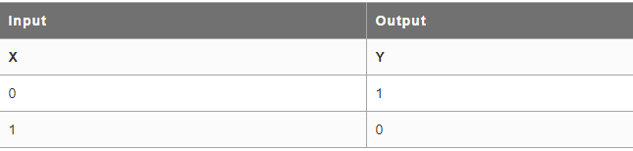
One’s Complement
One's Complement operator is a unary operator
It always precedes to the variable or an operand.
One's Complement operator inverts bits of its operand.
So, 1s becomes 0s and 0s becomes 1s.

Slide 52
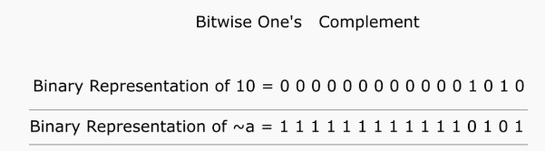
One’s Complement program
#include <stdio.h>
int main()
{
unsigned short int a = 10;
a = ~a;
printf("After One's Complement a = %u", a);
return 0;
}
65525

Slide 53
In Class Assignment
State the order of evaluation and result of following statements
X = 7 + 3 * 6 / 2 – 1 ;
X = 2 % 2 + 2 * 2 – 2 / 2 ;
x = (3 * 9 * (3 + (9 * 3 / (3))));

Slide 54

In Class Assignment

Slide 55
Q1. Point out the errors, if any, in the following C statements:
int = 314.562 * 150 ;
name = ‘Ajay’ ;
varchar = ‘3’ ;
3.14 * r * r * h = vol_of_cyl ;
k = ( a * b ) ( c + ( 2.5a + b ) ( d + e ) ;
m_inst = rate of interest * amount in rs ;
si = principal * rateofinterest * numberofyears / 100 ;
area = 3.14 * r ** 2 ;
volume = 3.14 * r ^ 2 * h ;
k = ( (a * b ) + c ) ( 2.5 * a + b ) ;
a = b = 3 = 4 ;
count = count + 1 ;
date = '2 Mar 04' ;

Slide 56
Q2. State the reasons for decimal integer constants to be incorrect.
12,245
36.0
10 20 30
123-45-6789
0900
Q3. State the reasons for floating point constants to be incorrect.
1
1,000.0
2E+10.2
3E 10
Q4. Consider the arithmetic expression
2 * ((i % 5) * (4 + ( j - 3) / (k + 2)))
where i , j and k are integer variables. If these variables are assigned the values 8, 15 and 4 respectively, then evaluate the given expression.

Slide 57
Q5. Suppose that i is an integer variable, x is a floating-point variable, d is a double-precision variable, and c is a character-type variable. The statements
printf( "integer: %d\n" , sizeof i ) ;
printf( " float : %d\n" , sizeof x ) ;
printf("double: %d\n" , sizeof d) ;
printf( "character: %d\n" , sizeof c) ;
might generate the following output.
Q6. Calculate the value of i==j?a-1:b+1 where
char a = `a', b = `b'; /* a has decimal value 97 */
int i = 1, j = 2;
double x = 7.07;

Slide 58
Thank You......

